Slide 1
NextGen Healthcare Analytics using Delta Lake
A End-to-End Healthcare FHIR Data Engineering & Analytics using Databricks Lakehouse
Team Members :
Data Ingestion Engineers - Mohanasharan K & Jothilingam D
Transformation Engineers - Sathyajith R & Angad Kumar
ML Engineers - Thiruvengadam K & Alagu Meenakshi
Dashboard & Documentation Engineers - Devesh Raaj & Sakthi Aravind

Slide 2
Project Overview
NextGen Healthcare Analytics using Delta Lake is an enterprise-grade Proof of Concept (POC) that demonstrates how complex FHIR (Fast Healthcare Interoperability Resources) JSON data can be ingested, governed, transformed, and analyzed using the Databricks Lakehouse architecture.
Project Objective & Key Outcomes :
Designed an end-to-end Healthcare Analytics POC using FHIR JSON data
Implemented Bronze–Silver–Gold Lakehouse architecture
Processed complex semi-structured healthcare data
Built analytics-ready datasets for reporting
Enabled admissions, diagnosis, and treatment trend analysis

Slide 3
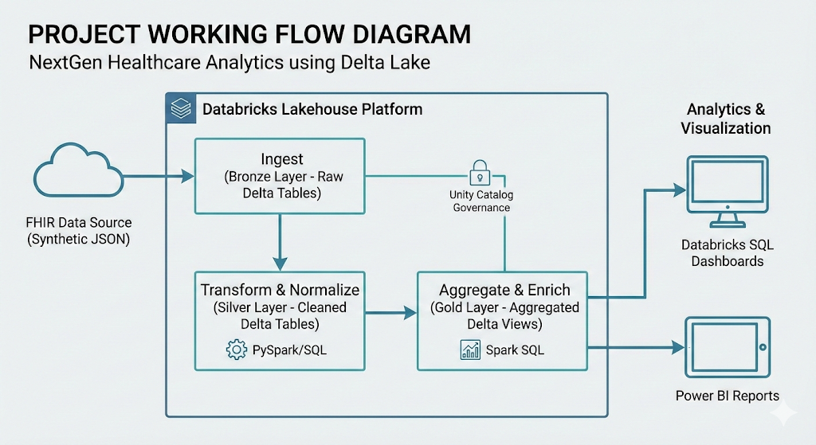

Slide 4
Databricks Workspace–Project Structure
Created a Centralized workspace for FHIR Healthcare Analytics :
Separate folders for:
Ingestion
Transformation
Analytics
Dashboards
Modular and team-aligned structure

Slide 5
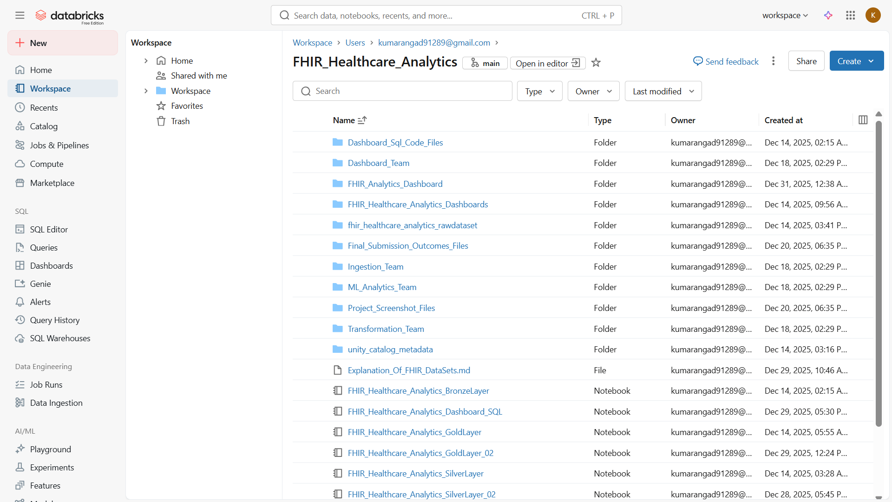

Slide 6
Bronze Layer – Raw FHIR Data Ingestion
Ingested raw FHIR JSON Bundles into Databricks
Stored data in Delta Lake Bronze tables
Preserved original structure and schema
Ensured immutable, auditable raw data
Raw FHIR JSON files stored in Databricks Volume
One JSON file = one patient bundle
Supports large-scale healthcare ingestion

Slide 7
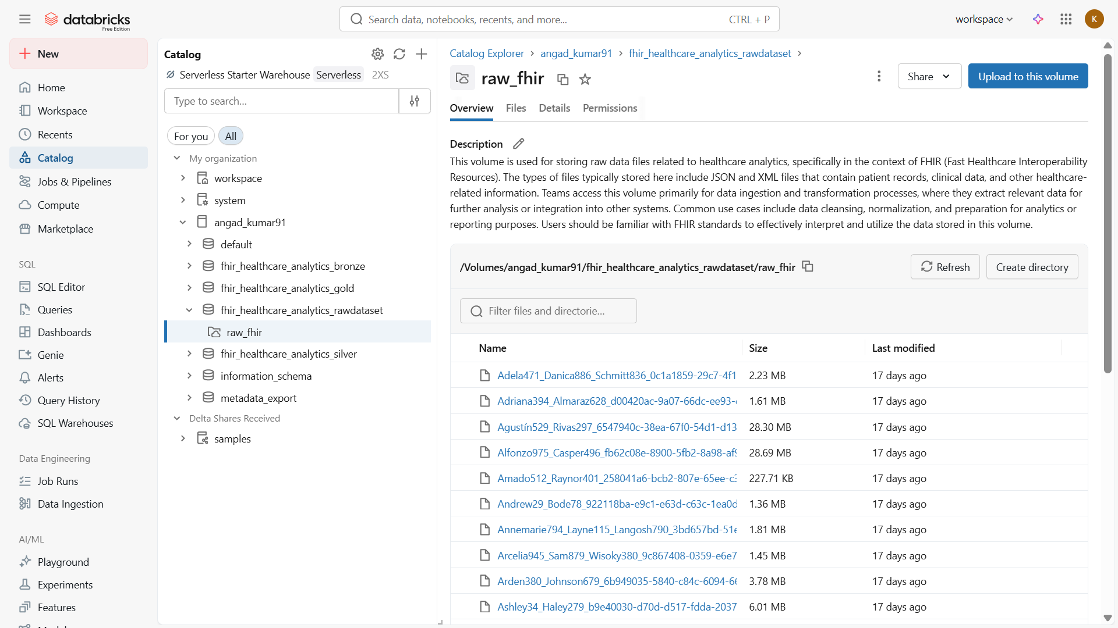

Slide 8
Unity Catalog / Catalog Structure
Catalog-based separation for :
Bronze
Silver
Gold
Clear ownership and schema-level organization
Governance-ready structure

Slide 9
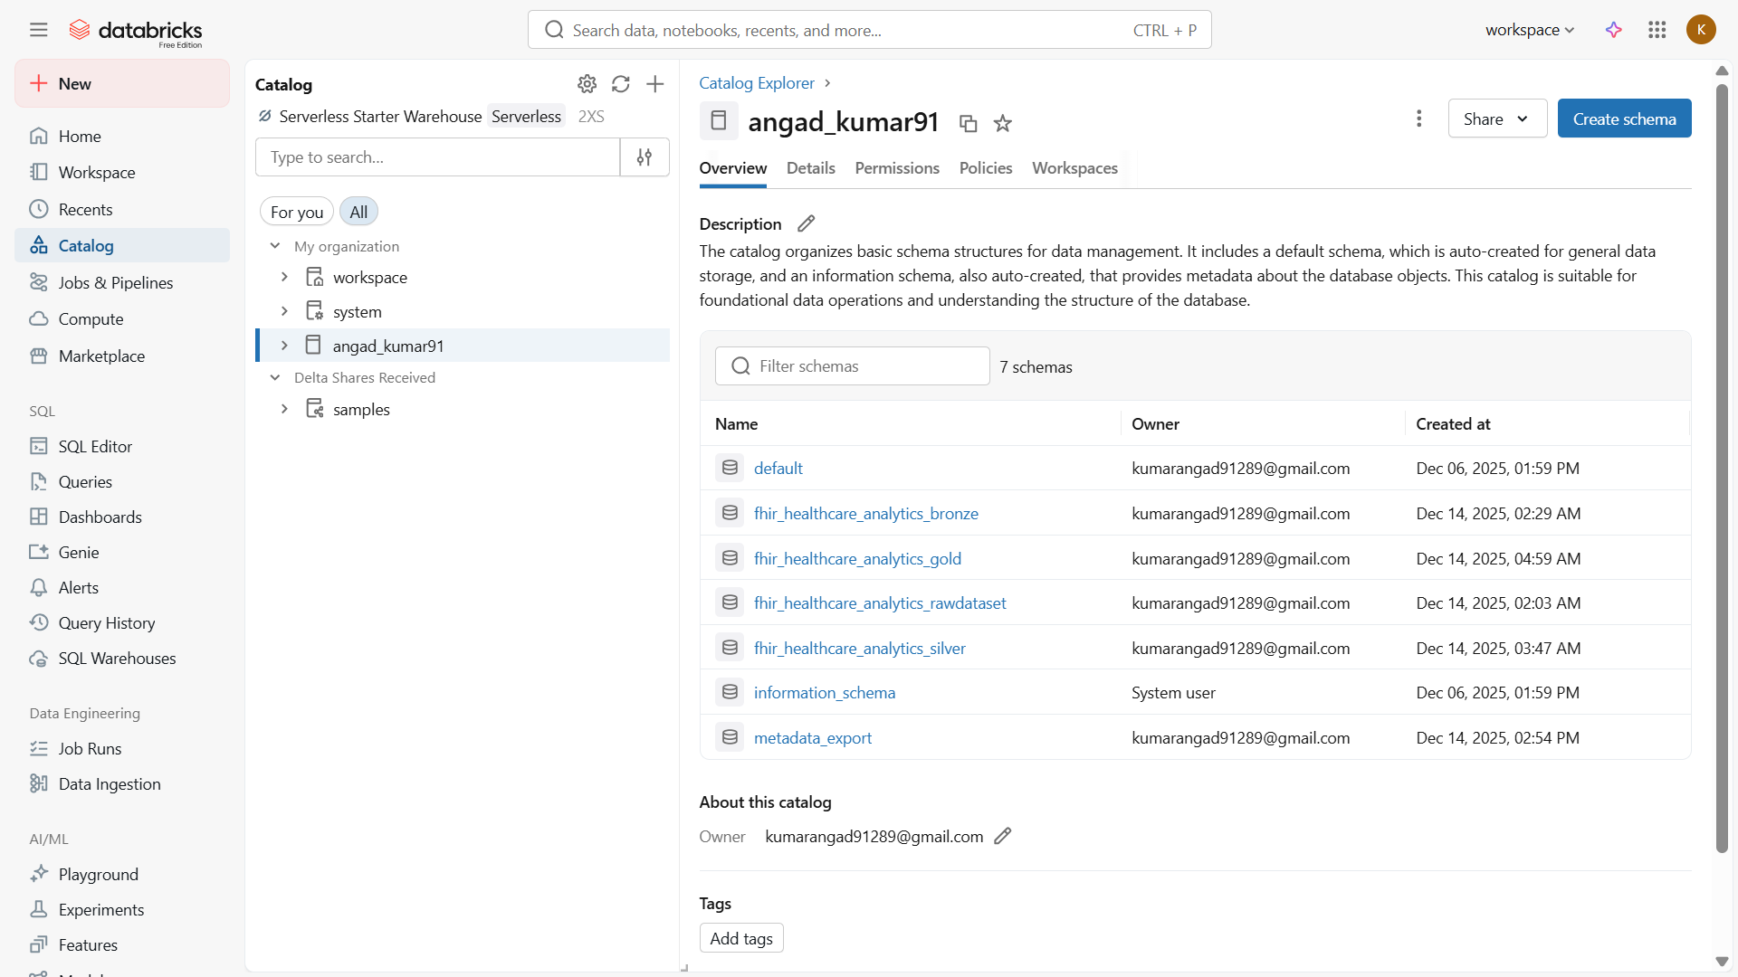

Slide 10
Sanity Check (Raw Files)
Raw Data Sanity Validation
Verified JSON file count
Confirmed one patient per file
FHIR Bundles exploded into individual resources
Resource types identified (Patient, Encounter, Condition, etc.)
Stored as Delta Bronze views

Slide 11
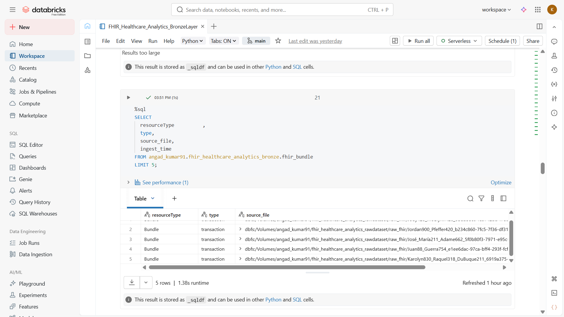

Slide 12
Verify files inside the Volume
Bronze Layer – We verifing the loaded json files :
Created Bronze exploded views
Enabled SQL and PySpark access
Foundation for Silver transformation
The JSON files are in the form of Bundle

Slide 13
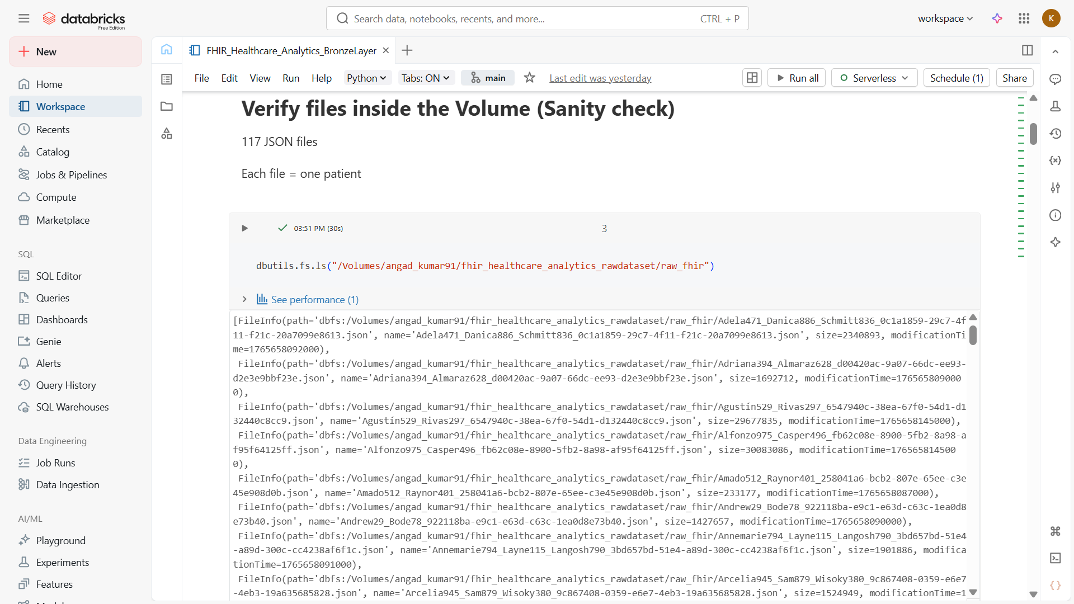

Slide 14
Bronze View Loading
Loading Bronze Layer for Tranformation – Resource-Level Views :
Created Bronze exploded views
Loading the files from bronze table
Enabled SQL and PySpark access
Foundation for Silver transformation

Slide 15
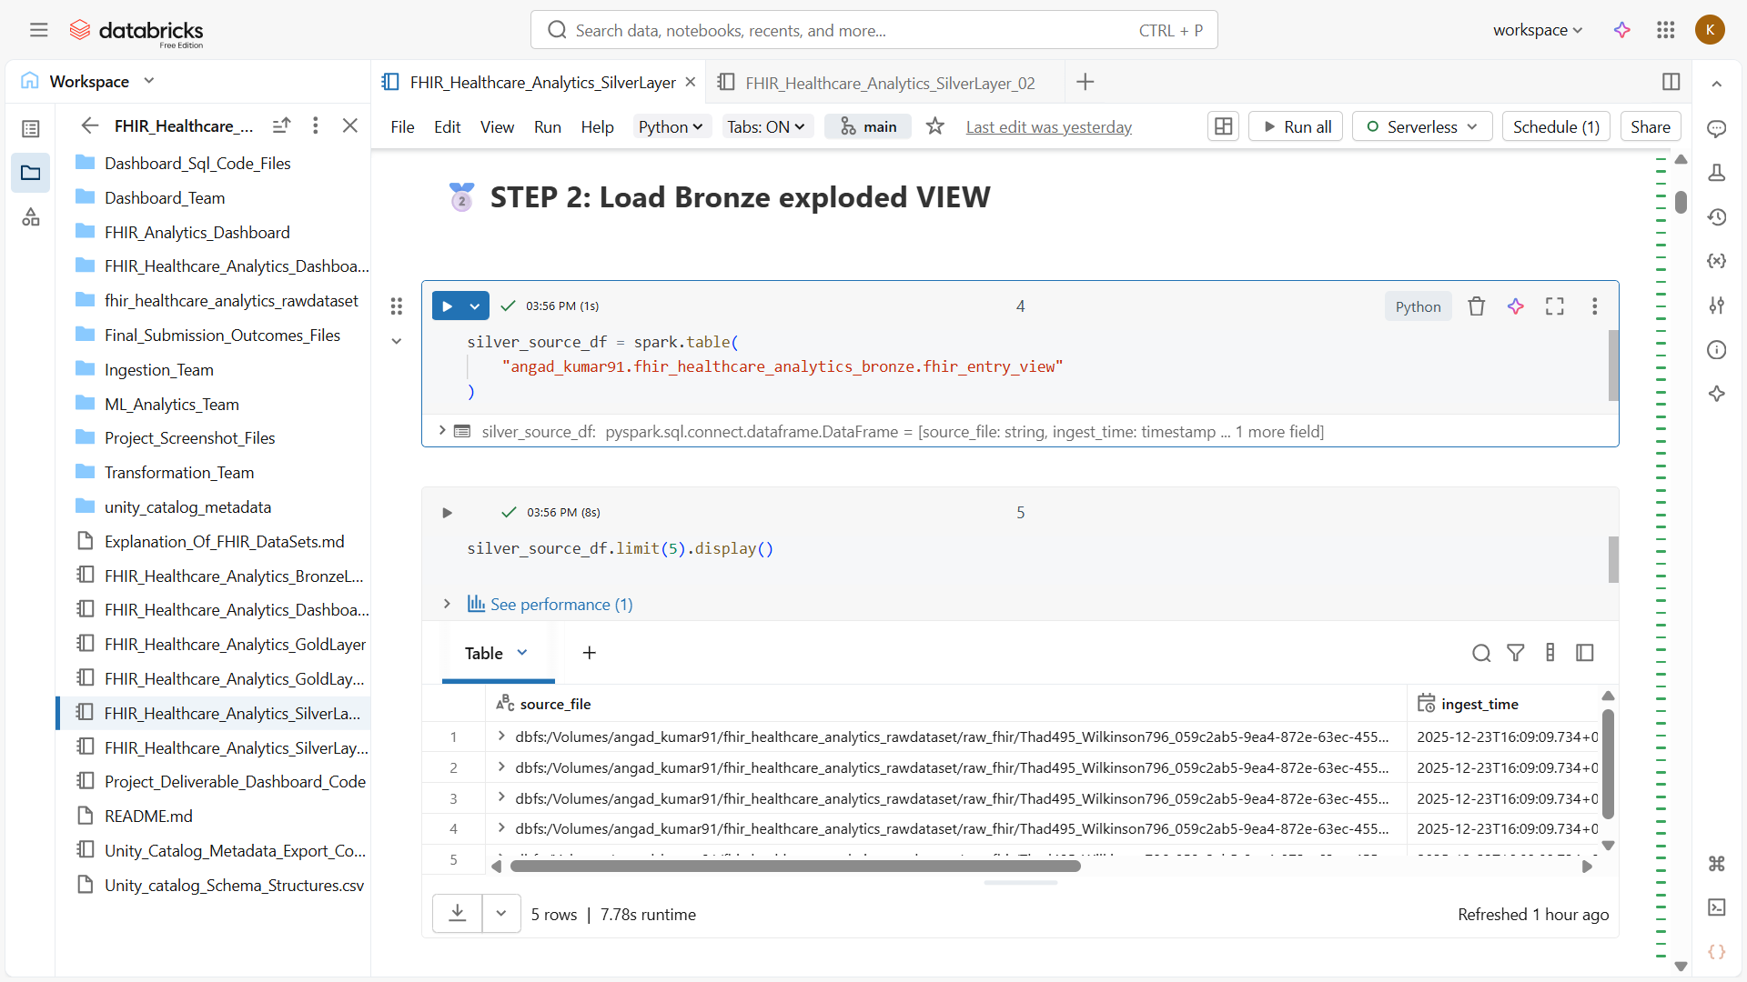

Slide 16
Working With Silver Tables - Patient Table
Silver Layer – Patient Normalization :
Flattened Patient resource
Cleaned demographics:
Gender
Birth date
Marital status
Address
Analytics-ready patient table

Slide 17
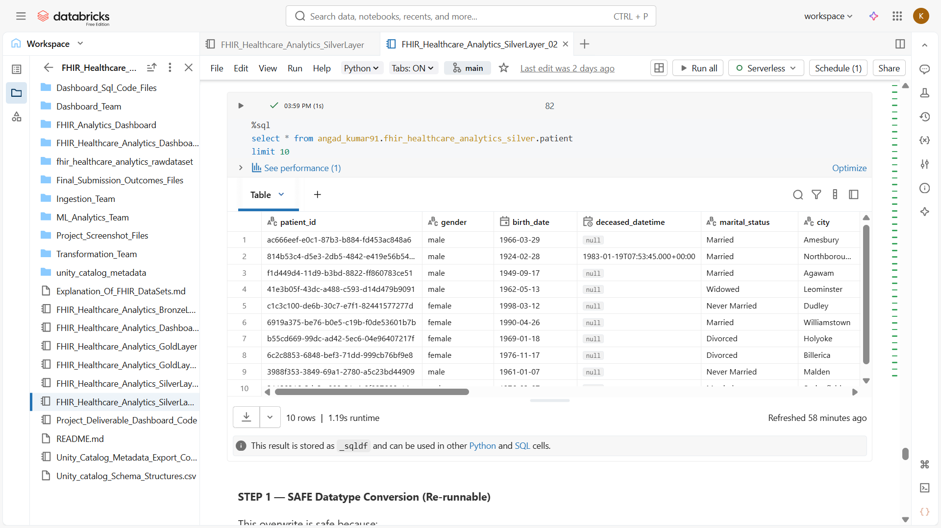

Slide 18
Silver Table - Immunization / Treatment Table
Extracted treatment-related resources
Linked encounters to treatments
Structured for trend analysis
Handling the Data-Validation

Slide 19
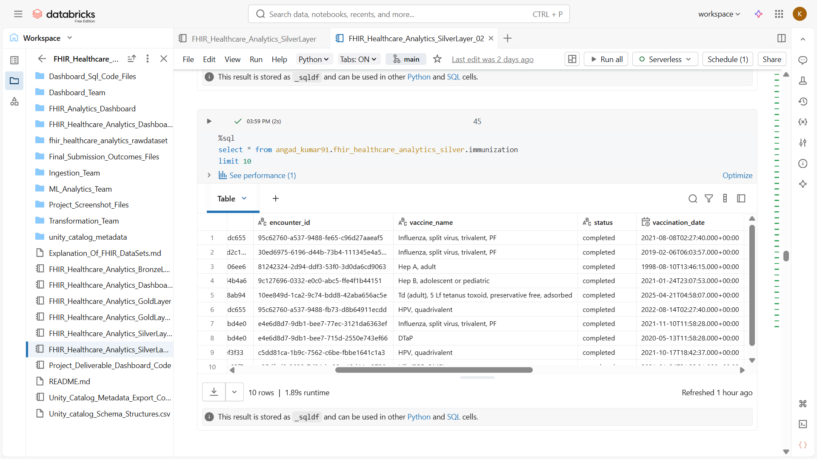

Slide 20
Gold Layer Workings – Diagnosis Breakdown
Aggregated diagnosis counts
Disease-wise patient distribution
Time-based diagnosis analysis
Procedure selection for Patient disorders

Slide 21
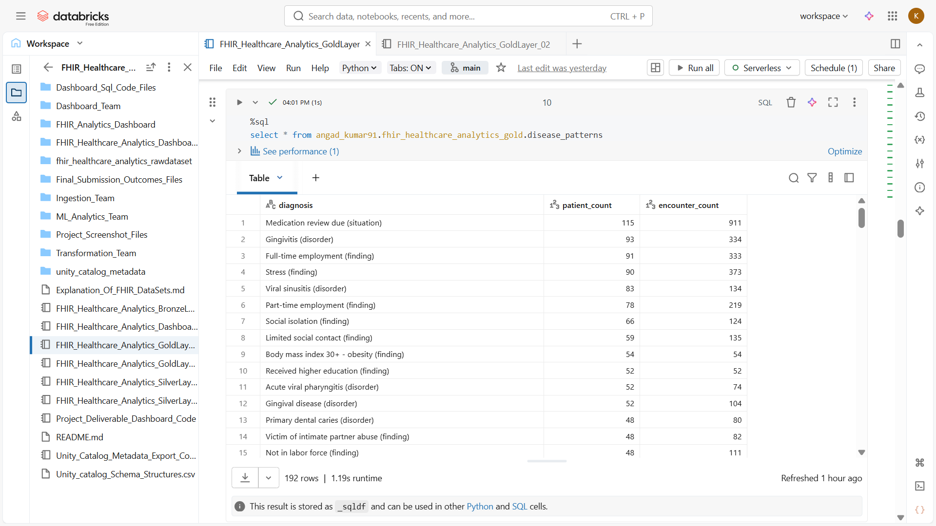

Slide 22
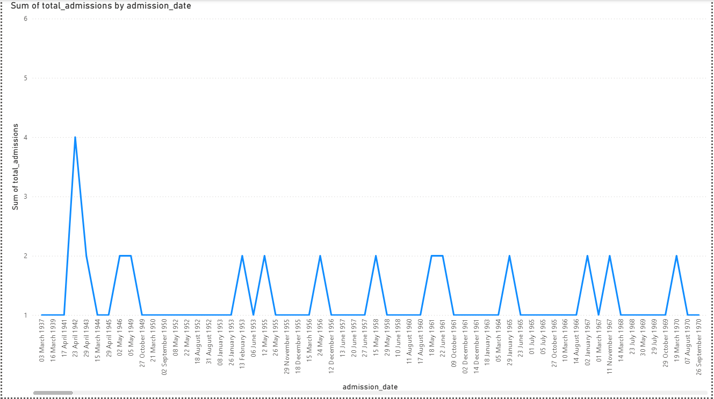
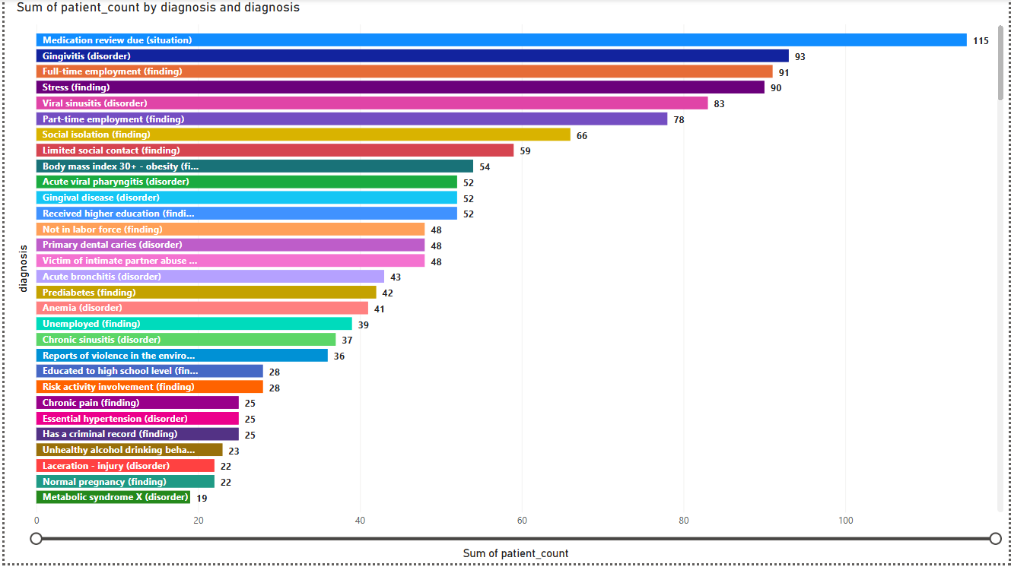
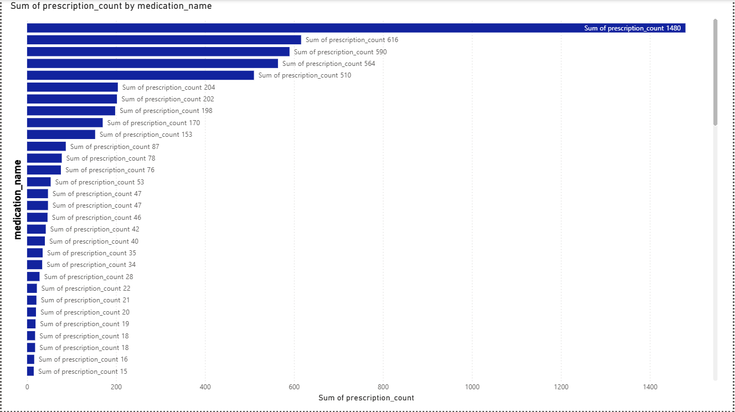
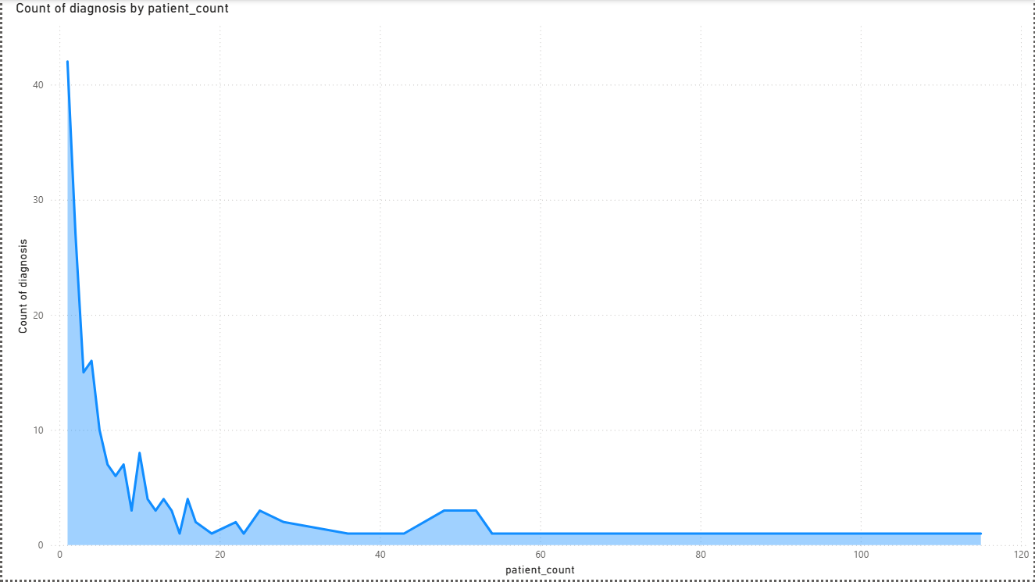

Slide 23
Gold Layer – Patient Admissions Fact
One row = one encounter
Metrics supported :
Admission count
Length of stay (LOS)
Admission type
Optimized for dashboards

Slide 24
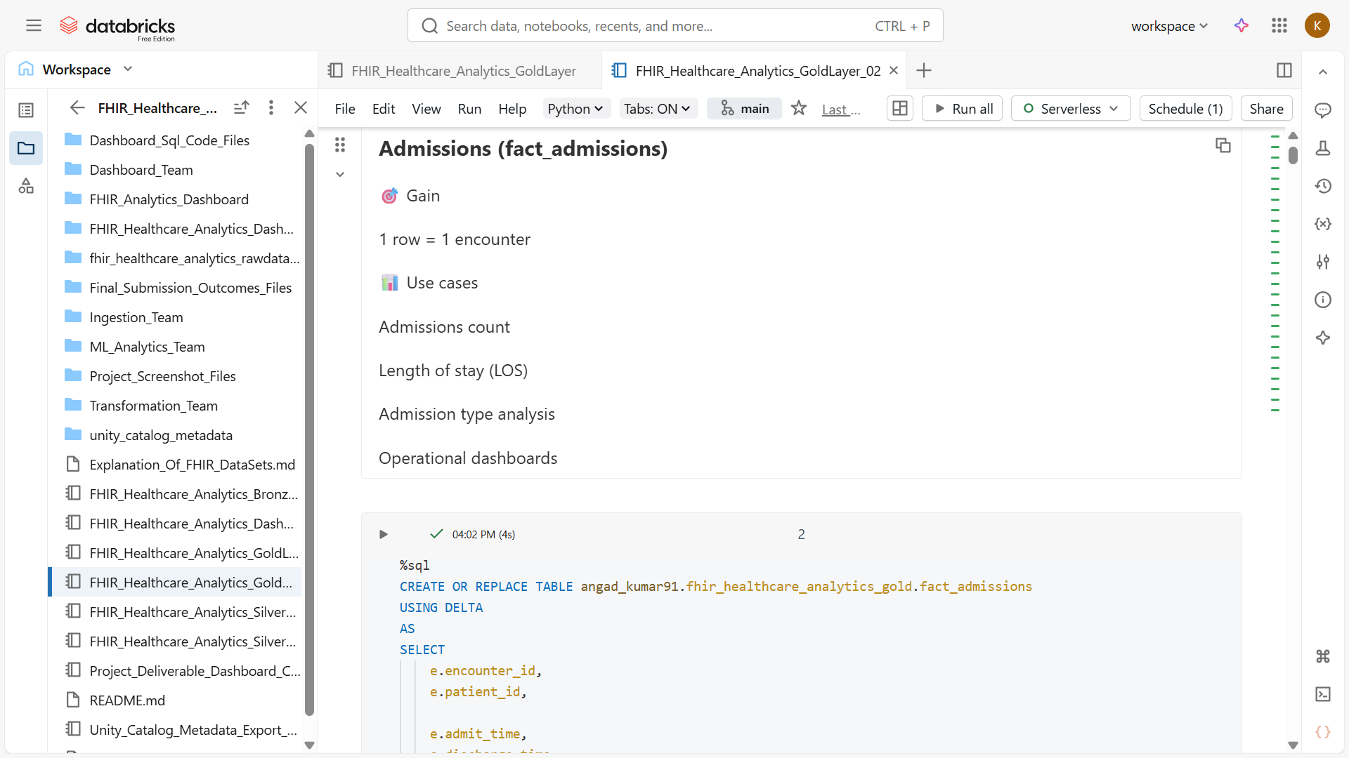

Slide 25
Creating Dashboard - Patient Admissions
Dashboard 1 – Patient Admissions :
Admissions over time
Admission type analysis
Length of stay metrics
Operational insights

Slide 26
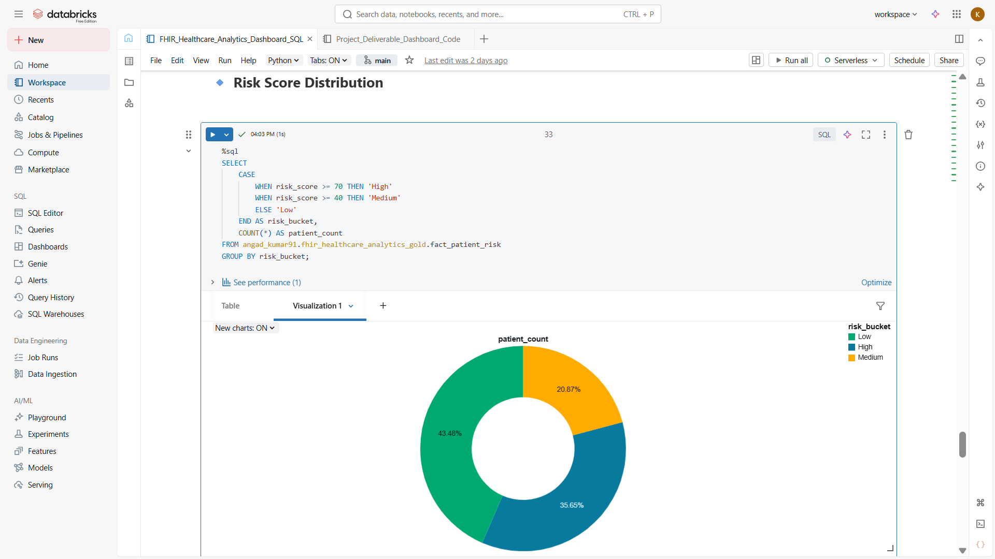

Slide 27
Building Dashboard for Delivarables
Patient Admissions Dashboard
Who is coming in, when, and how often ?
Diagnosis Breakdown Dashboard
What are patients being treated for ?
Treatment Trends Dashboard
What treatments, procedures, and medications are being used?”

Slide 28
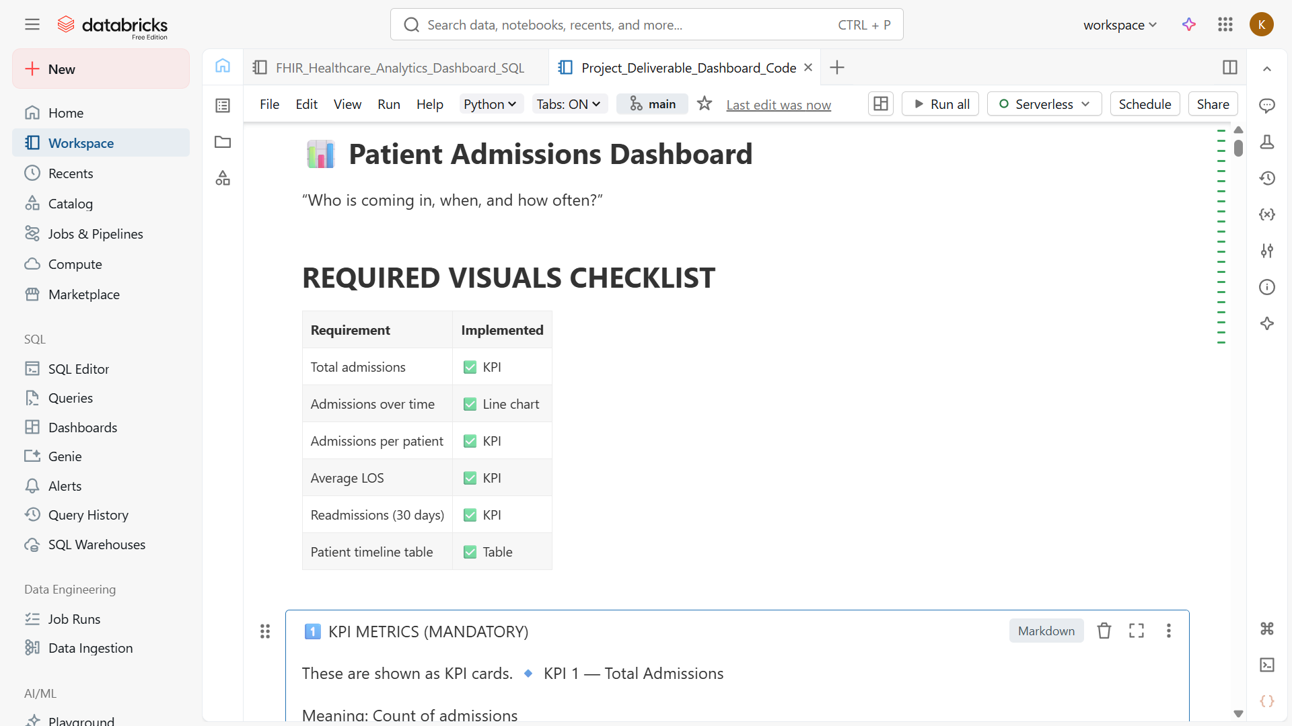

Slide 29
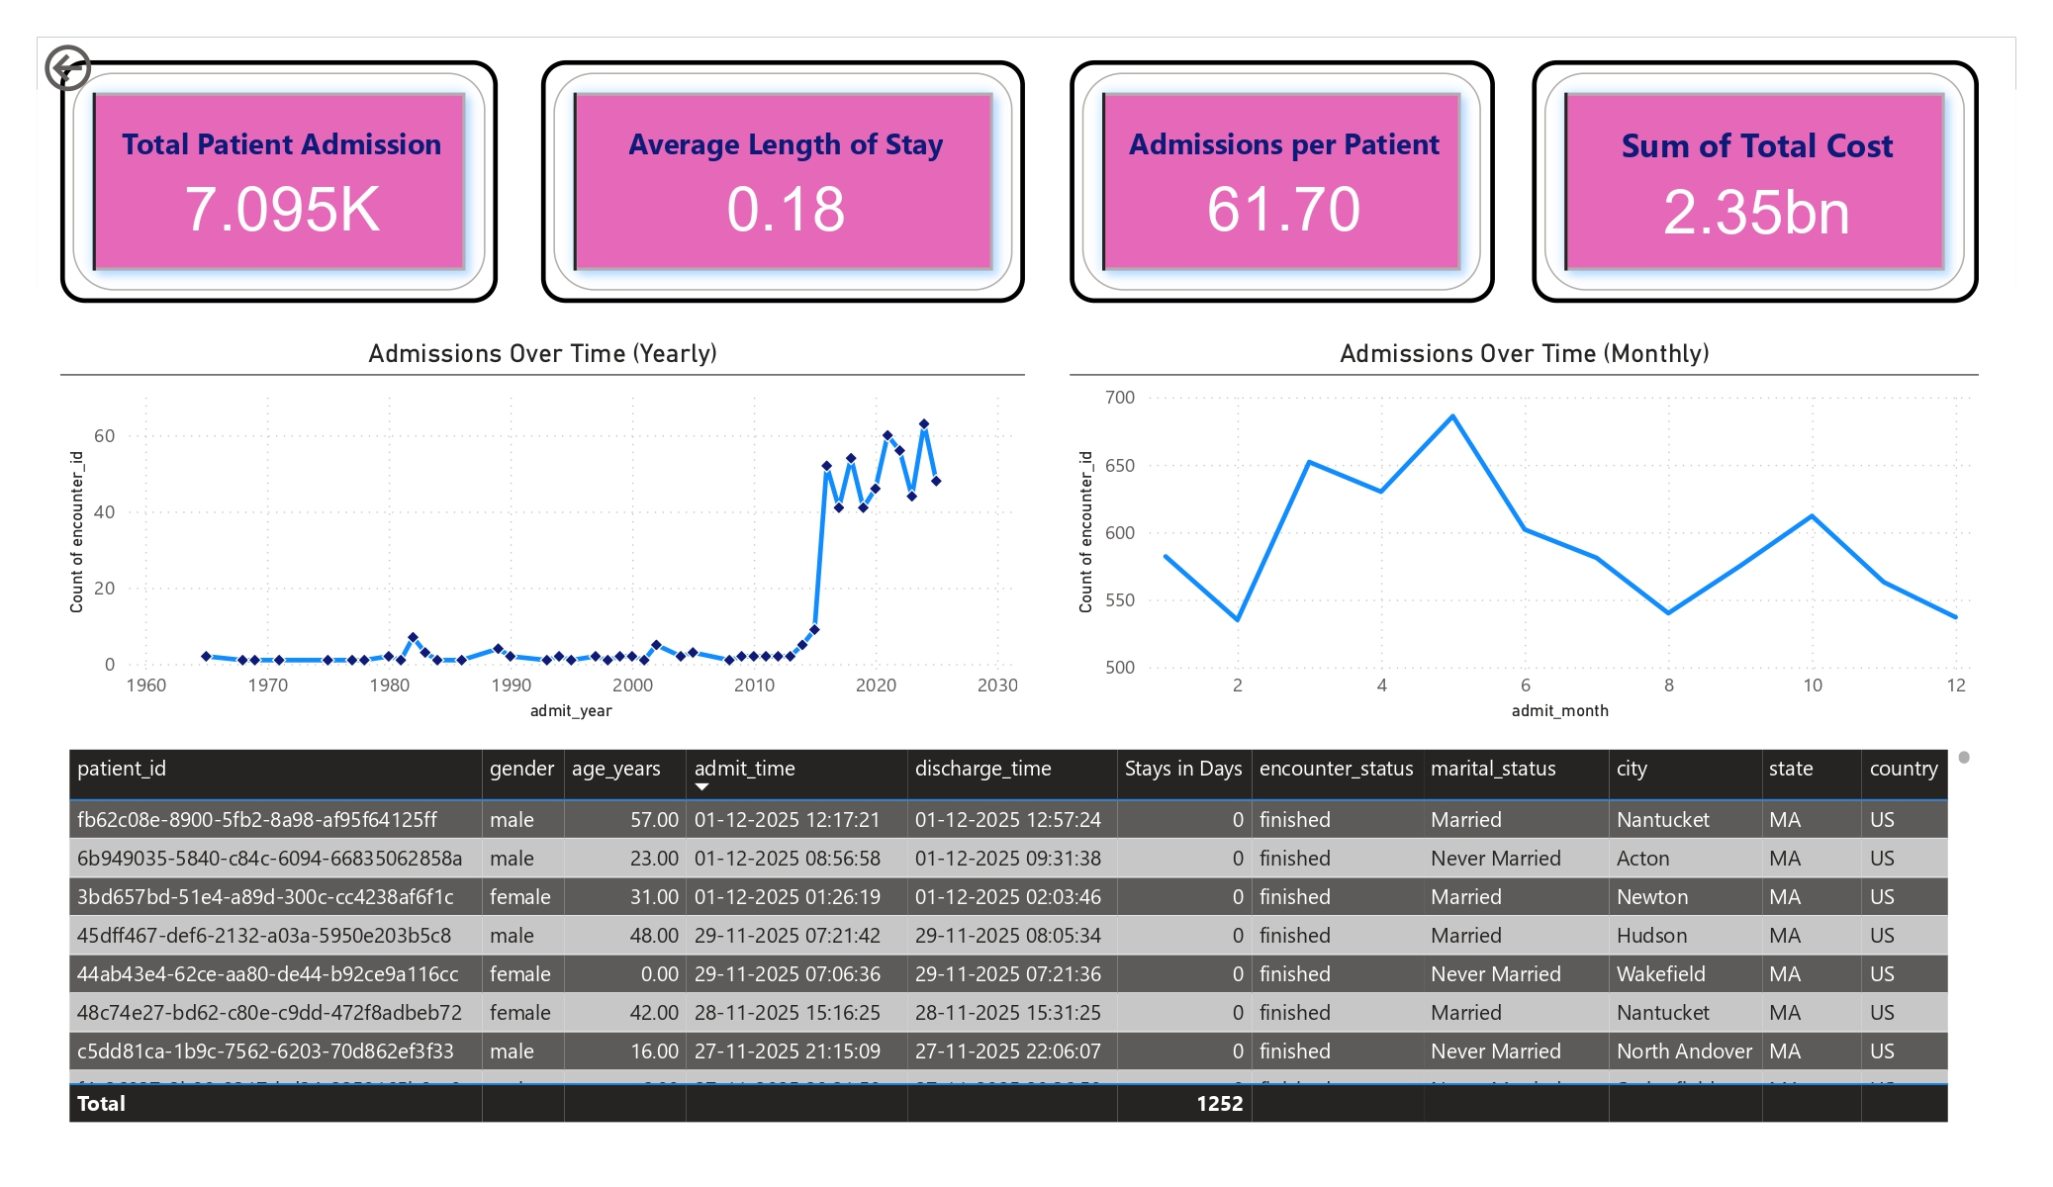
Patient Admissions Dashboard

Slide 30
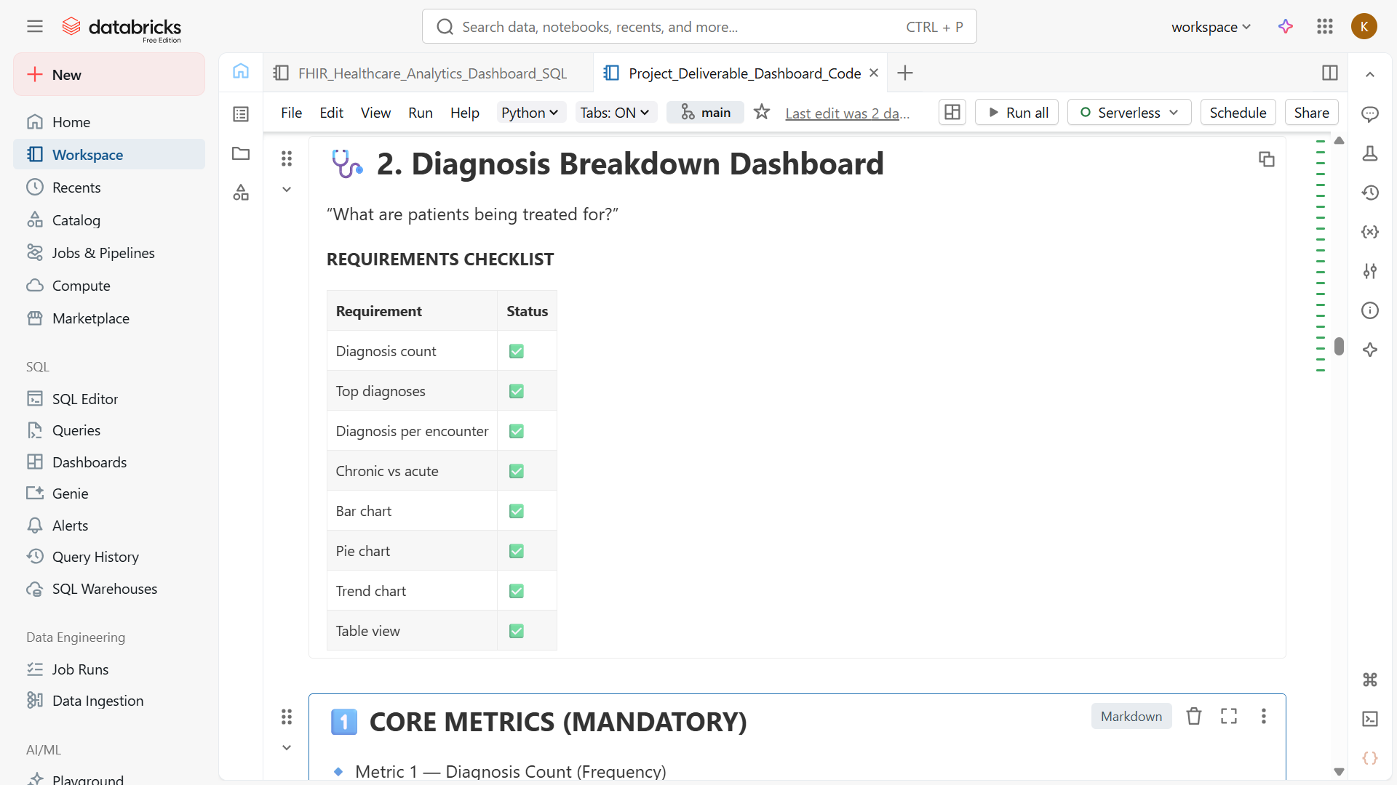

Slide 31
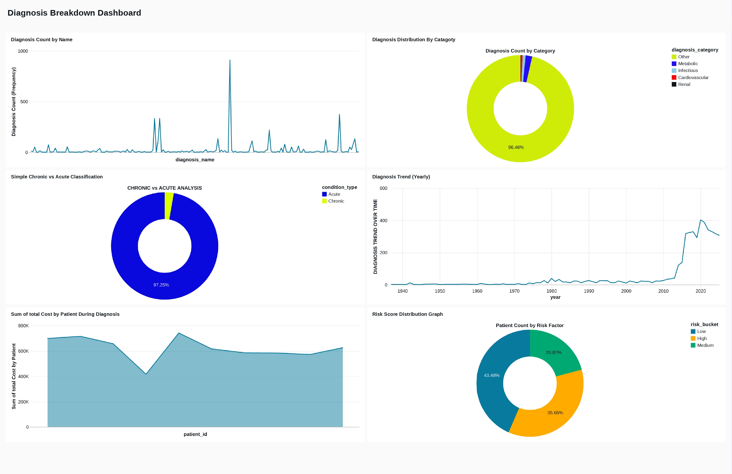

Slide 32
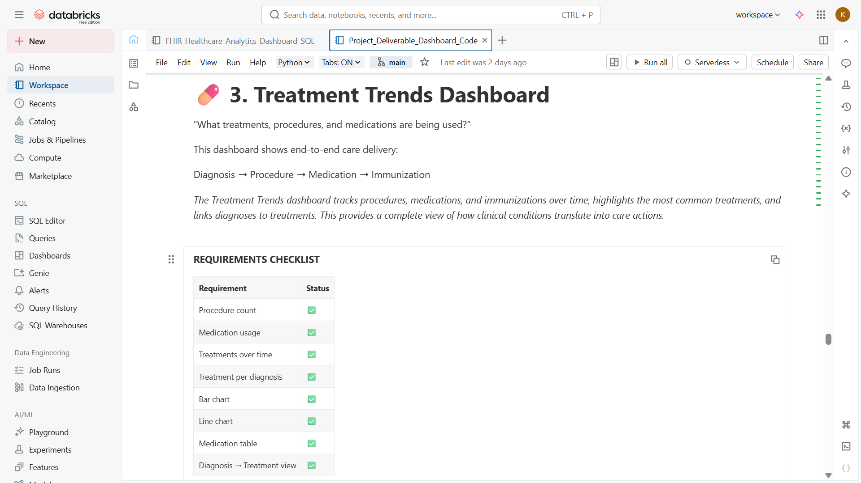

Slide 33
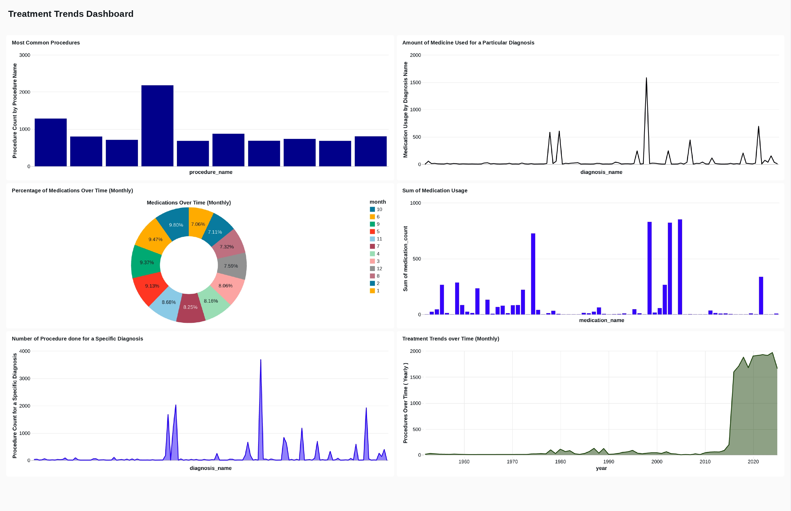

Slide 34


